Slide 1

Digital Monitoring cum Control of Power Transformer
By- Mr.

Slide 2
Introduction

Slide 3
LM35
Microcontroller
Relay
ON-OFF
Transformer
Transformer
Relay
Current Sensing Device

Slide 4
Arduino Is An Open Source Programmable Circuit Board That Can Be Integrated Into A Wide Variety Of Makerspace Projects Both Simple And Complex. This board contains a microcontroller which is able to be programmed to sense and control objects in the physical world. By responding to sensors and inputs, the Arduino is able to interact with a large array of outputs such as LEDs, motors and displays. Because of it’s flexibility and low cost, Arduino has become a very popular choice for makers and makerspaces looking to create interactive hardware projects. Arduino was introduced back in 2005 in Italy by Massimo Banzi as a way for non-engineers to have access to a low cost, simple tool for creating hardware projects. Since the board is open-source, it is released under a Creative Commons license which allows anyone to produce their own board.

Slide 5
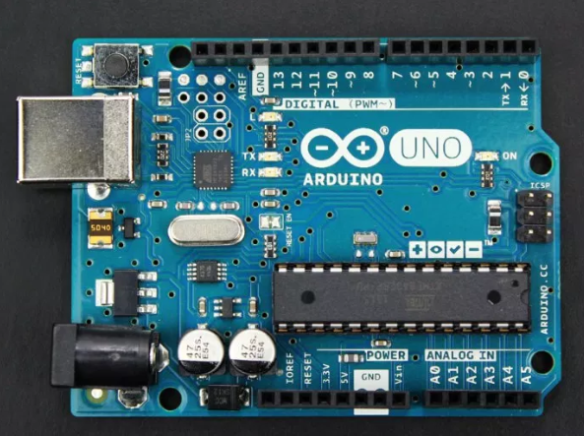

Slide 6
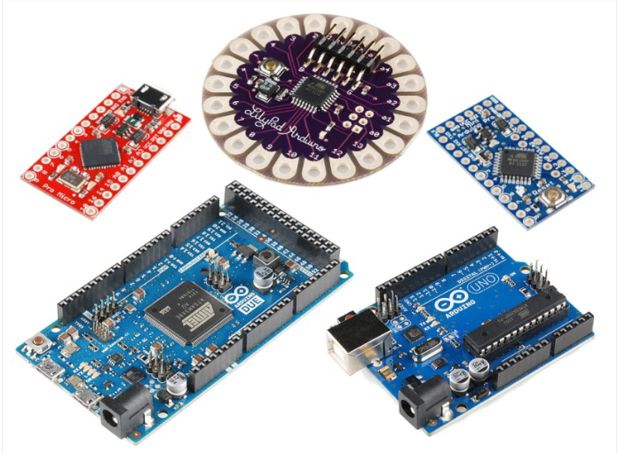
Types of Arduino Boards

Slide 7
One Of The Most Popular Arduino Boards Out There Is The Arduino Uno. While It Was Not Actually The First Board To Be Released, It Remains To Be The Most Actively Used And Most Widely Documented On The Market. Because Of Its Extreme Popularity, The Arduino Uno Has A Ton Of Project Tutorials And Forums Around The Web That Can Help You Get Started Or Out Of A Jam. We’re Big Fans Of The Uno Because Of It’s Great Features And Ease Of Use.
Arduino Uno

Slide 8
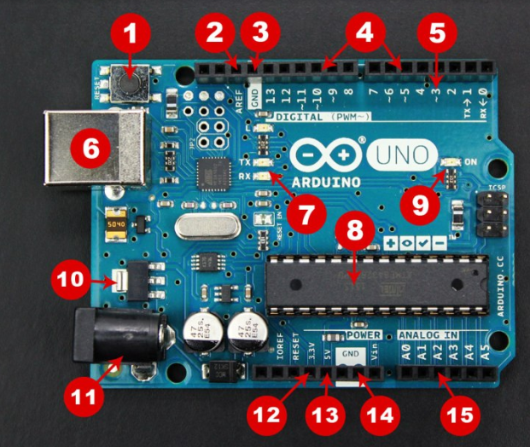

Slide 9
1. Reset Button – This will restart any code that is loaded to the Arduino board 2. AREF – Stands for “Analog Reference” and is used to set an external reference voltage 3. Ground Pin – There are a few ground pins on the Arduino and they all work the same 4. Digital Input/Output – Pins 0-13 can be used for digital input or output 5. PWM – The pins marked with the (~) symbol can simulate analog output 6. USB Connection – Used for powering up your Arduino and uploading sketches 7. TX/RX – Transmit and receive data indication LEDs

Slide 10
8. ATmega Microcontroller – This is the brains and is where the programs are stored 9. Power LED Indicator – This LED lights up anytime the board is plugged in a power source 10. Voltage Regulator – This controls the amount of voltage going into the Arduino board 11. DC Power Barrel Jack – This is used for powering your Arduino with a power supply 12. 3.3V Pin – This pin supplies 3.3 volts of power to your projects 13. 5V Pin – This pin supplies 5 volts of power to your projects 14. Ground Pins – There are a few ground pins on the Arduino and they all work the same 15. Analog Pins – These pins can read the signal from an analog sensor and convert it to digital

Slide 11
Once The Circuit Has Been Created On The Breadboard, You’ll Need To Upload The Program (Known As A Sketch) To The Arduino. The Sketch Is A Set Of Instructions That Tells The Board What Functions It Needs To Perform. An Arduino Board Can Only Hold And Perform One Sketch At A Time. The Software Used To Create Arduino Sketches Is Called The IDE Which Stands For Integrated Development Environment. The Software Is Free To Download And Can Be Found at https://www.arduino.cc/en/Main/Software
How To Program Arduino

Slide 12
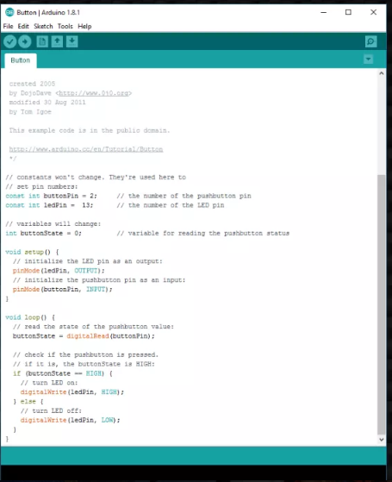

Slide 13
Every Arduino sketch has two main parts to the program: void setup() – Sets things up that have to be done once and then don’t happen again. void loop() – Contains the instructions that get repeated over and over until the board is turned off.

Slide 14
The following syntax and functions that you find in the sketches:
; semi-colons
// single line comments
/* */ multi-line comments
{ } open and closing curly braces
( ) parenthesis
void setup() – identify the opening and closing curly braces
void loop() – identify the opening and closing curly braces
some blue keywords like OUTPUT or INPUT

Slide 15
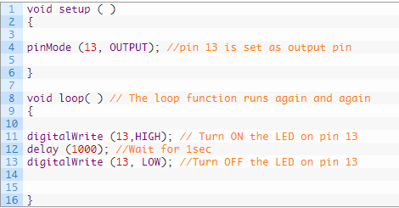

Slide 16
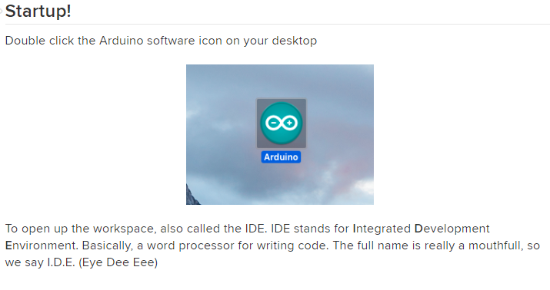

Slide 17
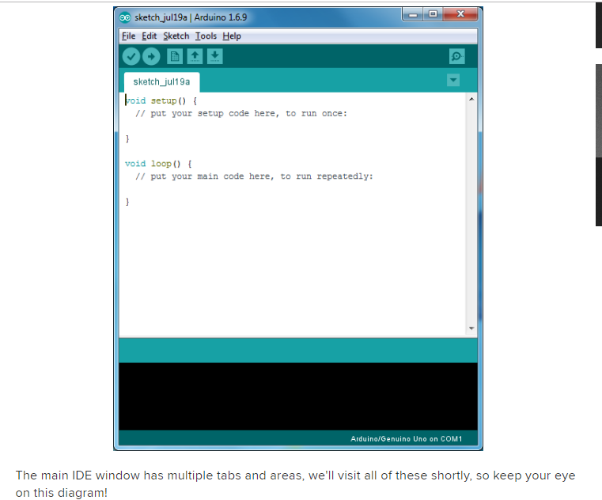

Slide 18
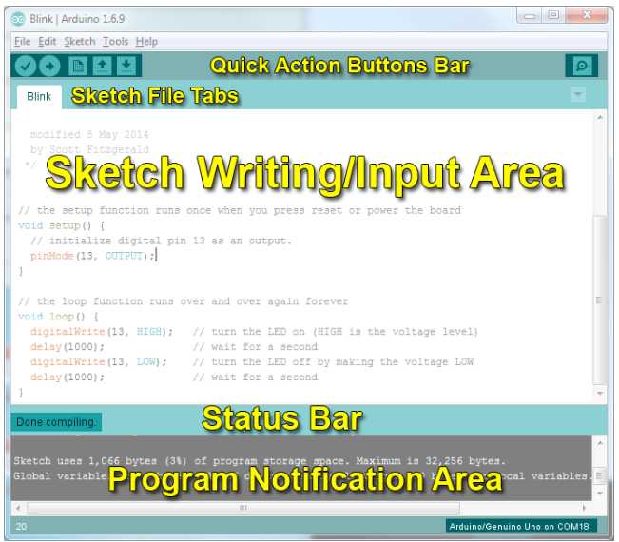

Slide 19
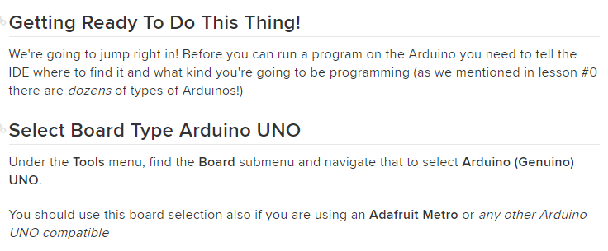

Slide 20
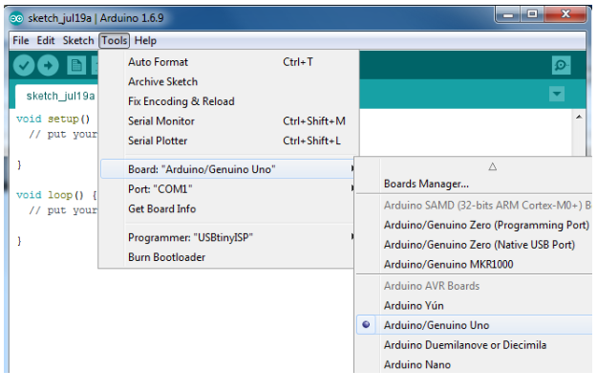

Slide 21
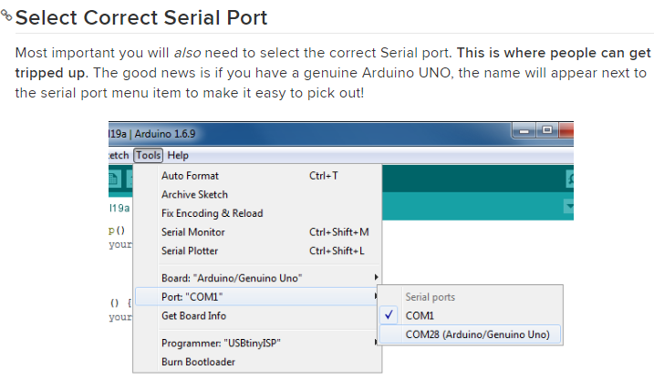

Slide 22
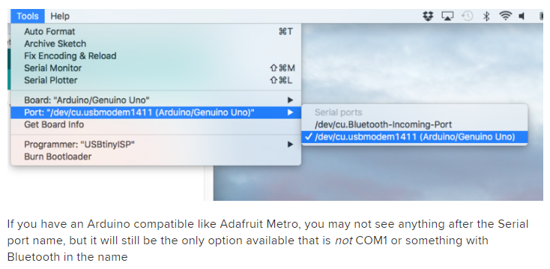

Slide 23
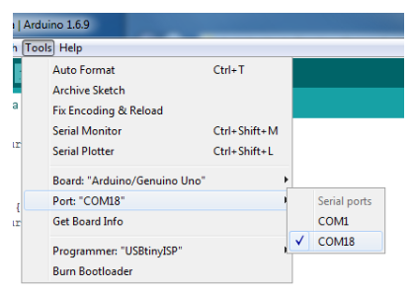

Slide 24
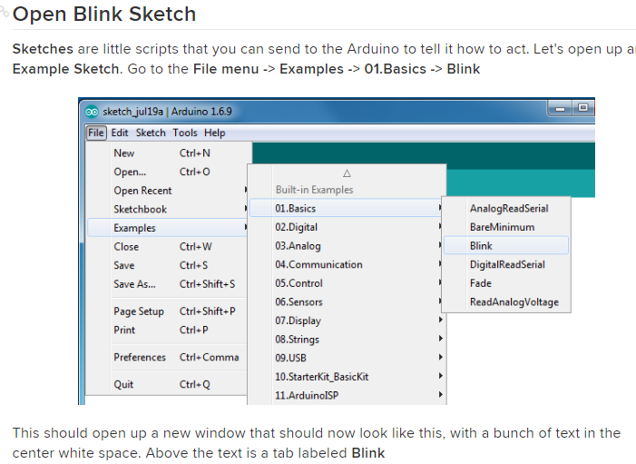

Slide 25
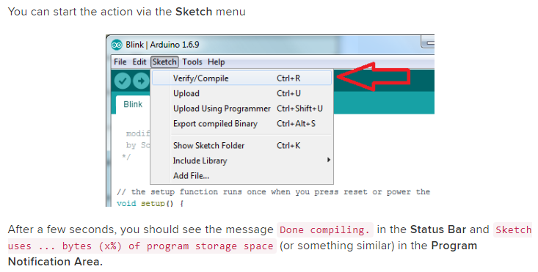

Slide 26
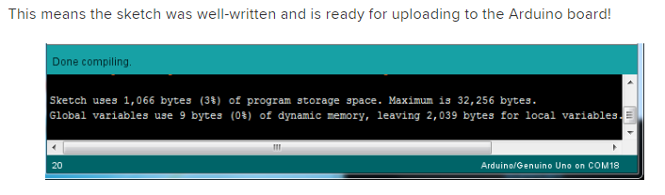

Slide 27
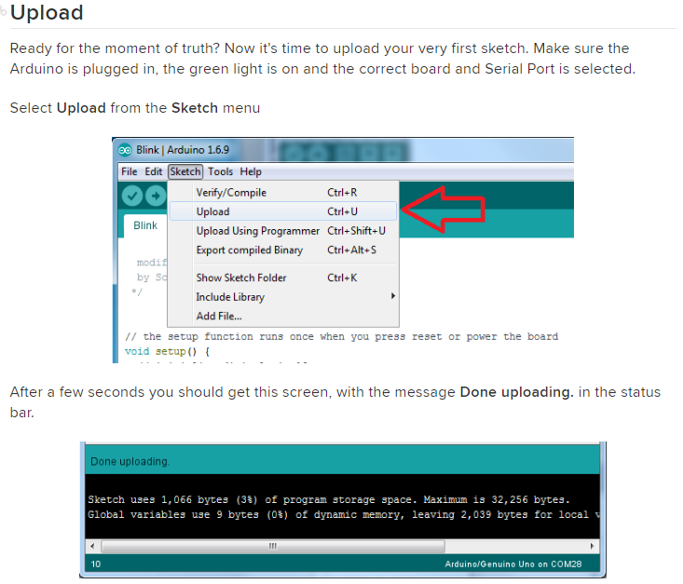

Slide 28
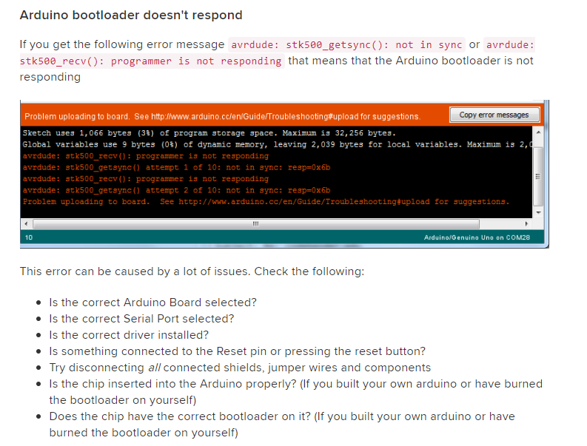

Slide 29
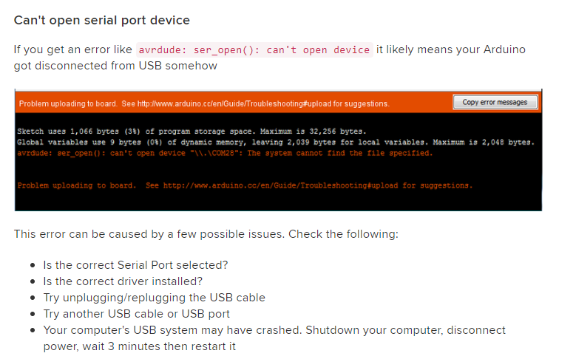

Slide 30
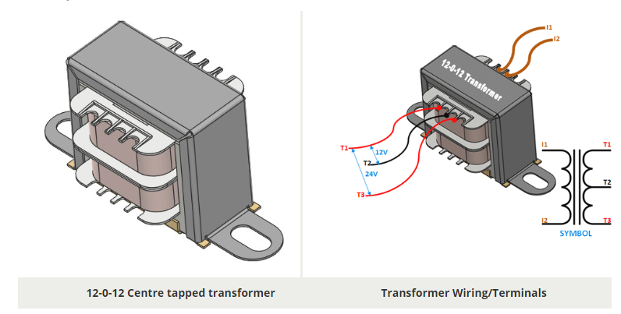

Slide 31
Transformer
Transformer has 240 V primary windings and centre tapped secondary winding.
The transformer has flying colored insulated connecting leads ( Approx 100 mm long ).
The Transformer act as step down transformer reducing AC - 240V to AC - 12V.
The Transformer gives two outputs of 24V, 12V and 0V. The Transformer's construction is written below with details of Solid Core and Winding.
The transformer is a static electrical device that transfers energy by inductive coupling between its winding circuits.
A varying current in the primary winding creates a varying magnetic flux in the transformer's core and thus a varying magnetic flux through the secondary winding.
This varying magnetic flux induces a varying electromotive force (E.M.F) or voltage in the secondary winding.
The transformer has cores made of high permeability silicon steel. The steel has a permeability many times that of free space and the core thus serves to greatly reduce the magnetizing current and confine the flux to a path which closely couples the windings.

Slide 32
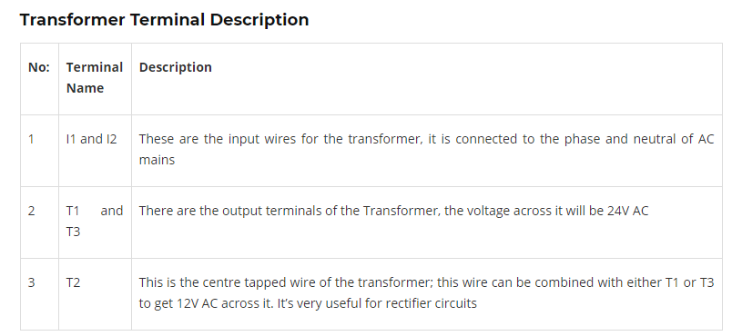

Slide 33
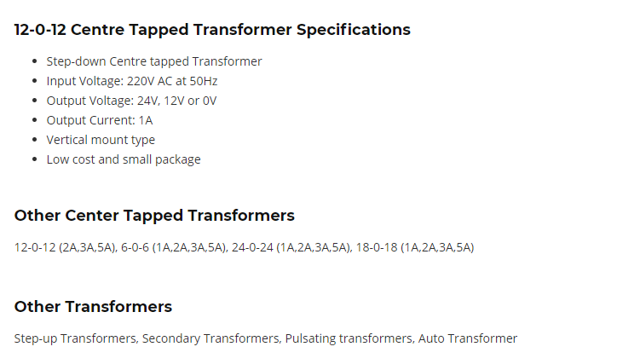

Slide 34
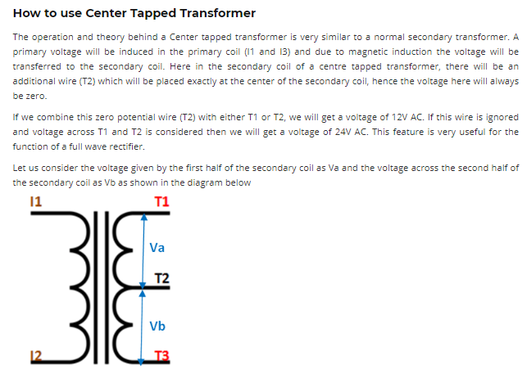

Slide 35
A Brief Note on ACS712 Current Sensor
The ACS712 Current Sensor is a product of Allegro MicroSystems that can be used for precise measurement of both AC and DC currents. This sensor is based on Hall Effect and the IC has an integrated Hall Effect device.
Coming to the output of the ACS712 Current Sensor, it produces an analog voltage that is proportional to AC or DC currents (whichever is being sensed).
The ACS712 IC is available in an 8-lead SOIC package and the following image shows its pin diagram.

Slide 36
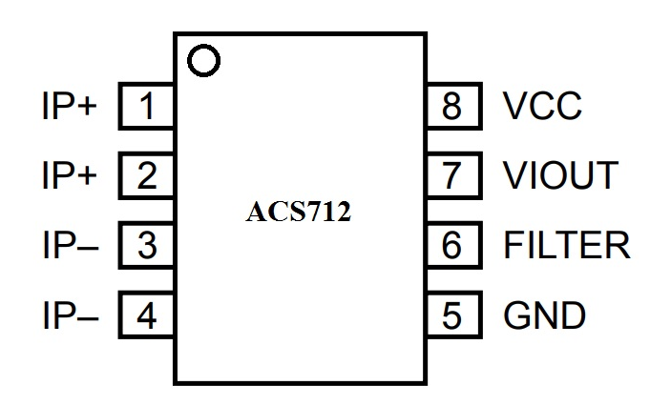

Slide 37
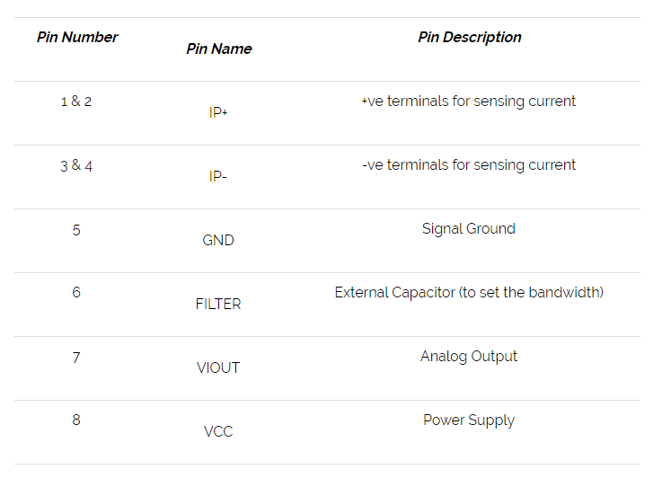

Slide 38
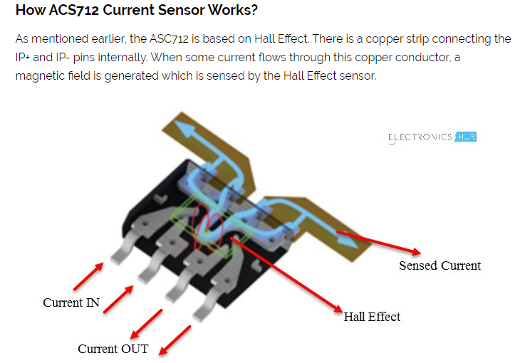
Current Sensor

Slide 39
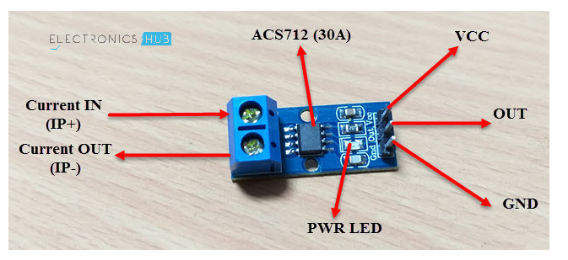
Device

Slide 40
Thank You….!

